Slide 1
Electric Ireland Data Lake
Sandip Mondal
19-11-2018

Slide 2
Hadoop Essentials & Cost Benefit Analysis
Electric Ireland Data Lake Team

Slide 3
Overview
Introduction
Vendor Comparison
Enterprise Data Hub (EDH)
Solution Architecture
Benefits Realized in ESB & EI

Slide 4
Introduction
Introduction
Vendor Comparison
Enterprise Data Hub (EDH)
Solution Architecture
Benefits Realized in ESB & EI

Slide 5
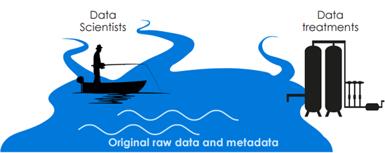
Overview

Slide 6
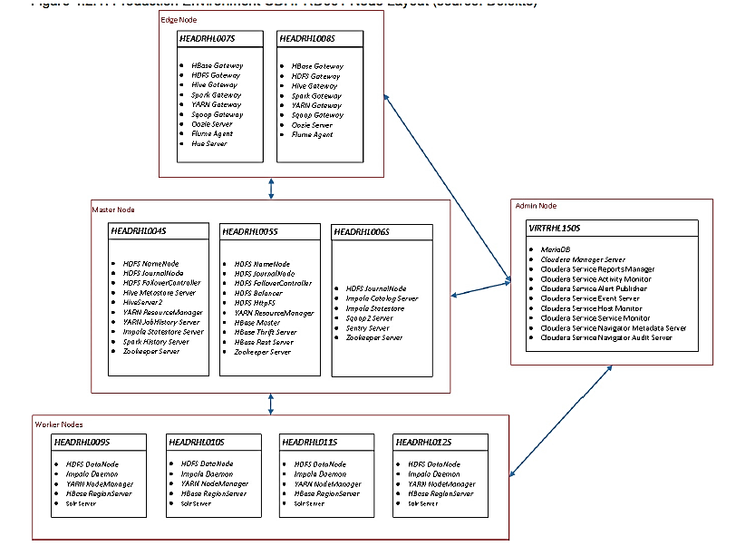
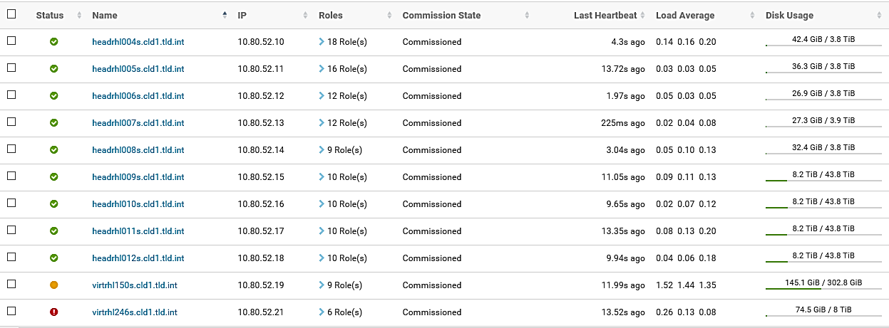
Infrastructure of Electric Ireland Data Lake Environment

Slide 7
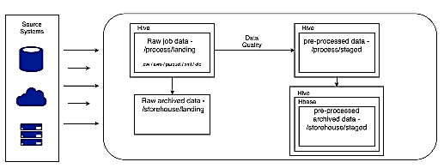
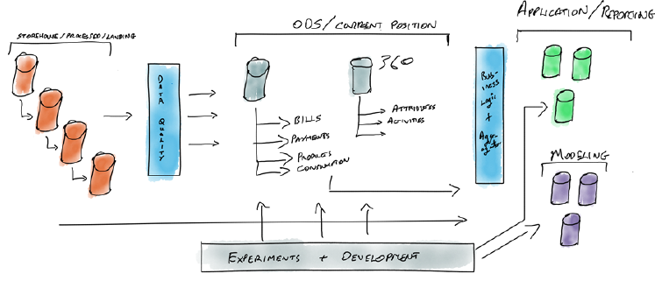
Architecture of Data Lake
Overall Data Flow
Sources for the Lake feed HDFS or Hive tables which are then cleaned, transformed and ready to be loaded further into Hive, HBase and Impala tables for use by Data Analysts and Data Scientists.
Data Layers in the Lake
Layer 1: Process/ Storehouse/ Staging (Raw Data)
Layer 2: ODS/360Customer (Cleaned and Transformed Data)
Layer 3: Application / Reporting ( Data as per specific Business Needs like CM, BrkrMgmt, Smarter Homes)

Slide 8


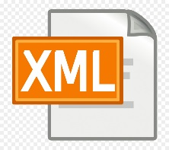
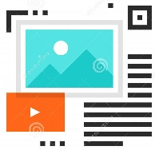



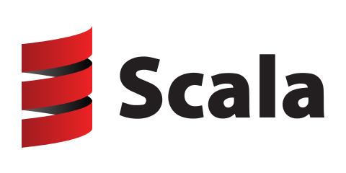



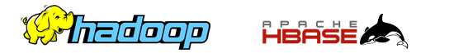
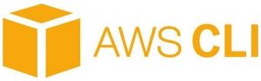
Sources of the Data Lake
Traditional Relational Database
Flat Files
Semi-Structured Files
CMDM
Residential Portal
BBS (Trading DB)
SAP (SRP, IRP, CRP, SAP BW)
ABTRAN
ARVATO
LIBERTY
SIEMENS
SNIPP
SMARTPAYG
NETWORKS
BROKER SOA
GEO DIRECTORY
Smart PayG Profile values
Unstructured Files
Call recordings from ARVATO
Cloud Sources
AWS Hosted by Accenture housing Smarter Home information

Slide 9
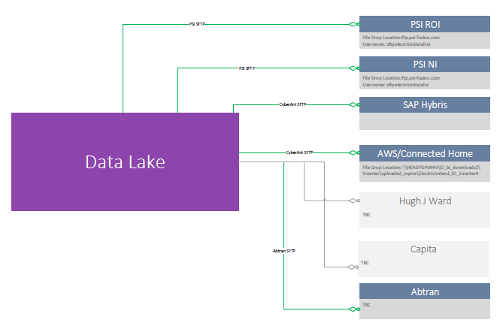




Applications of the Data Lake – Data Extracts

Slide 10
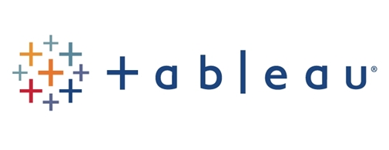
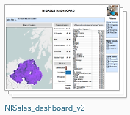
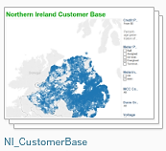

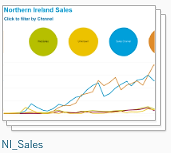

Applications of the Data Lake – Dash Boards / Reports
Broker Management

Slide 11
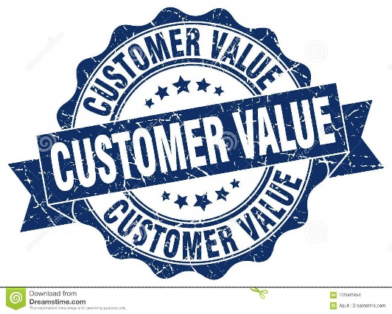
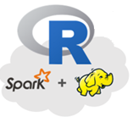

Applications of the Data Lake – Modelling
Value Model
The customer value provides a focused approach to understanding the target customer in the context of our tariffs.
The major activities that bear on the revenue and profitability potential of customers: (1) the effort to acquire new customers, (2) the challenge of retaining them, and (3) the various means of increasing their value.
A Predictive Churn Model is a tool that defines the steps and stages of customer churn, or a customer leaving. Having a predictive churn model gives awareness and quantifiable metrics to fight against in retention efforts. This gives the ability to pattern habits of customers who leave, and step in before they make that decision.
Churn Model

Slide 12

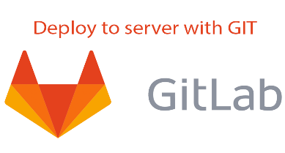
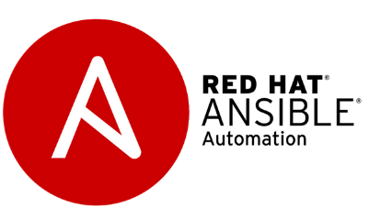

DevOps Integration in the Data Lake
Jenkins is a self-contained, open source automation server which can be used to automate all sorts of tasks related to building, testing, and delivering or deploying software.
From project planning and source code management to CI/CD and monitoring, GitLab is a single application for the entire DevOps lifecycle.
Ansible is open source software that automates software provisioning, configuration management, and application deployment. Ansible connects via SSH, remote PowerShell or via other remote APIs.
Maven is a build automation tool used primarily for Java projects. Maven addresses two aspects of building software: first, it describes how software is built, and second, it describes its dependencies.

Slide 13
END

